Slide 1


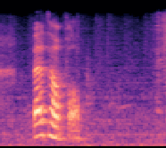
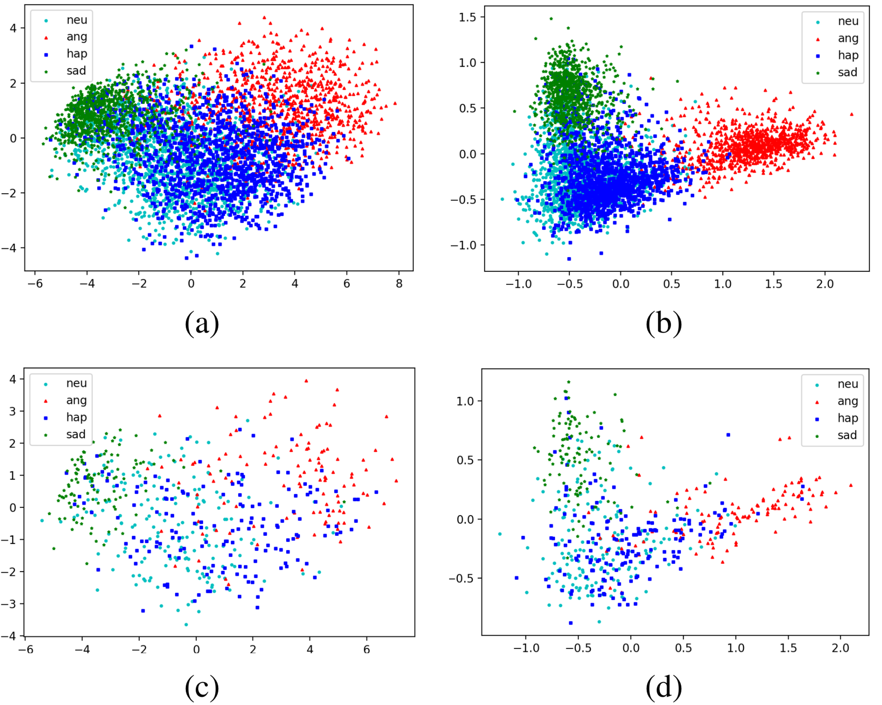

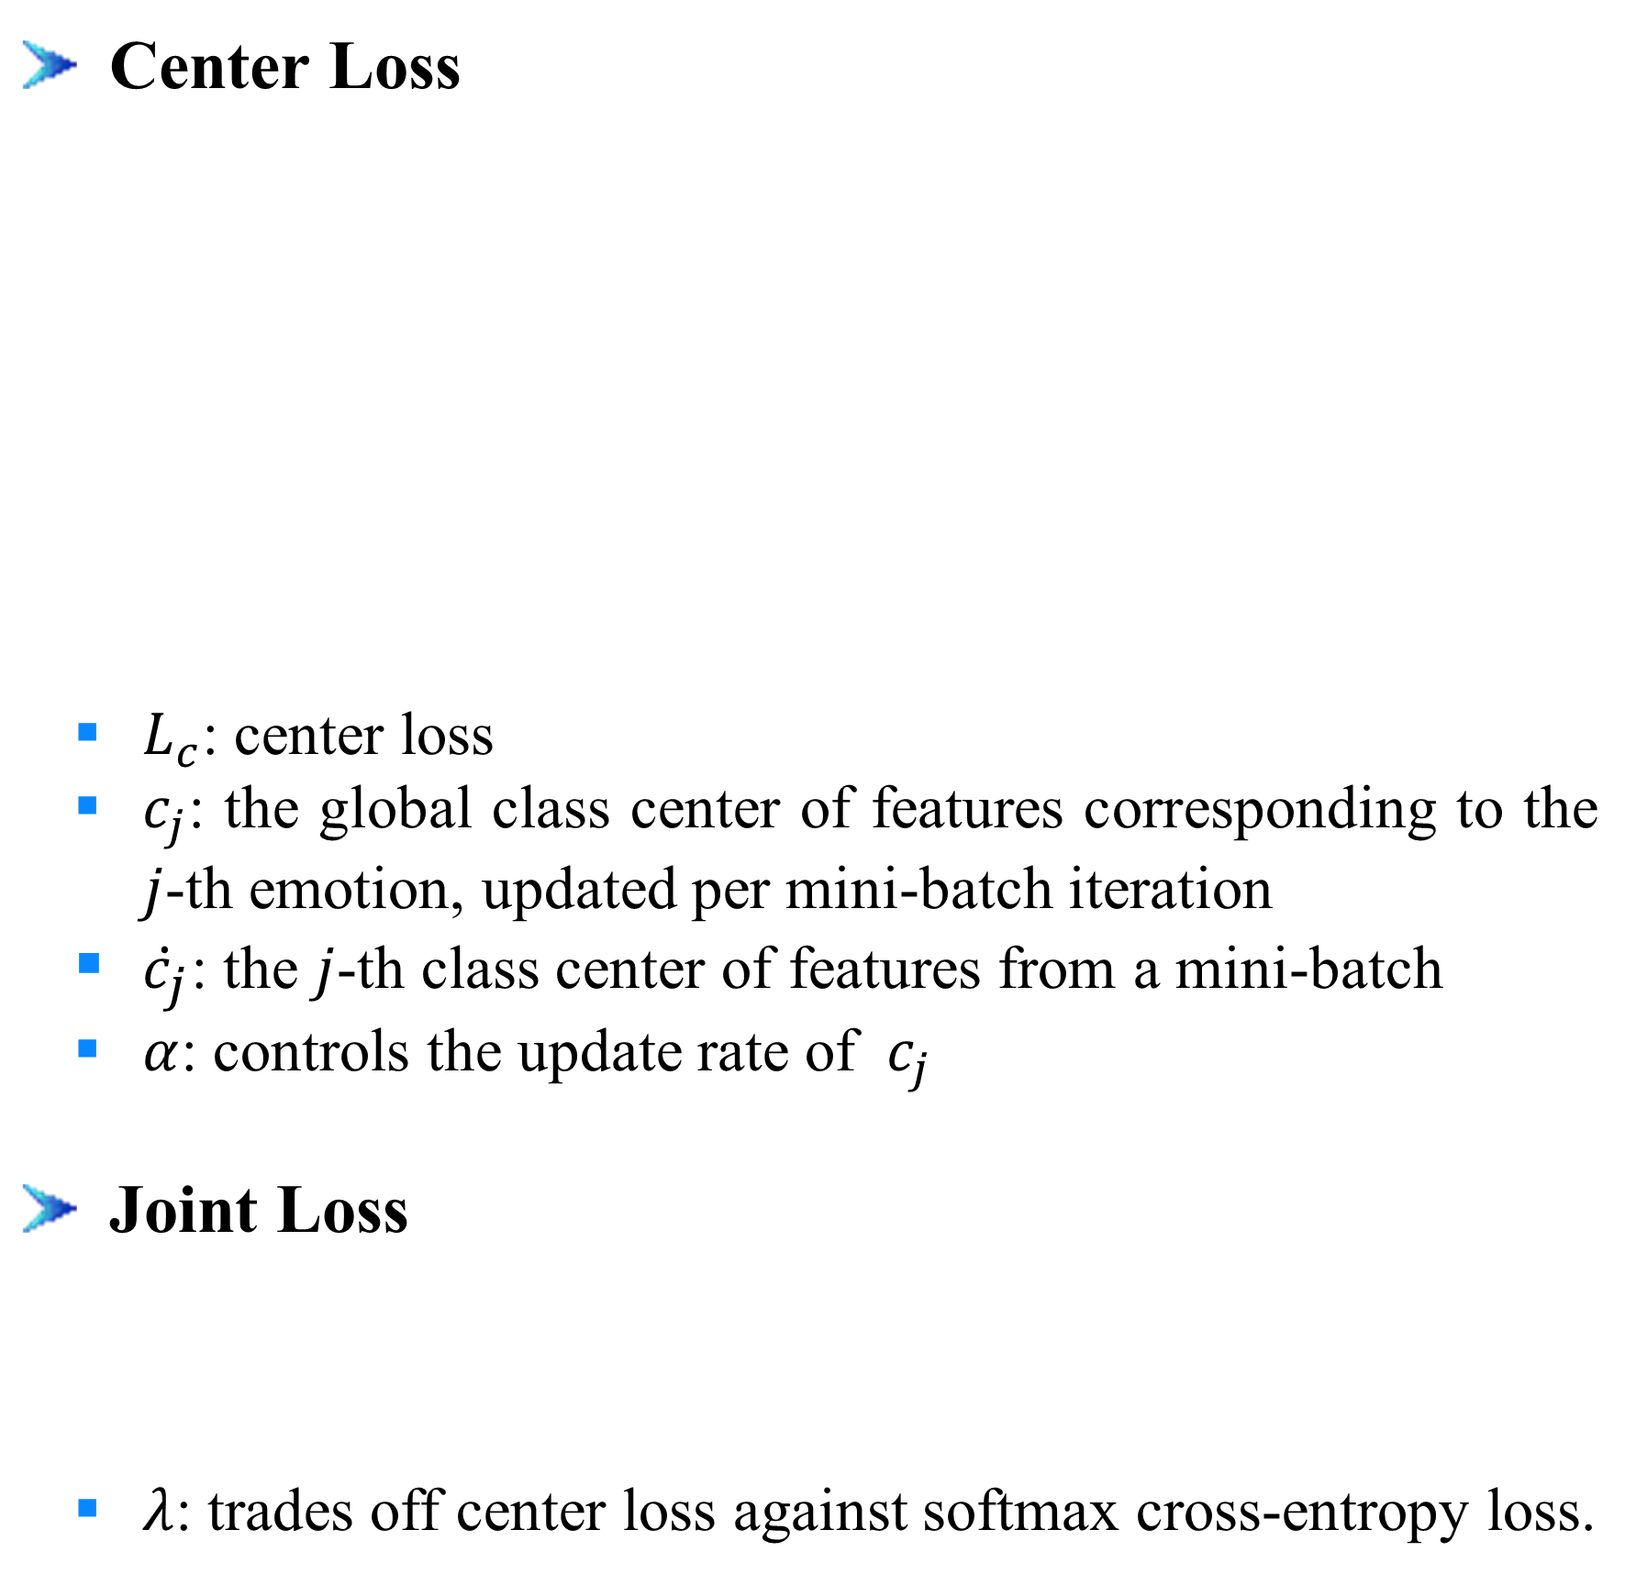
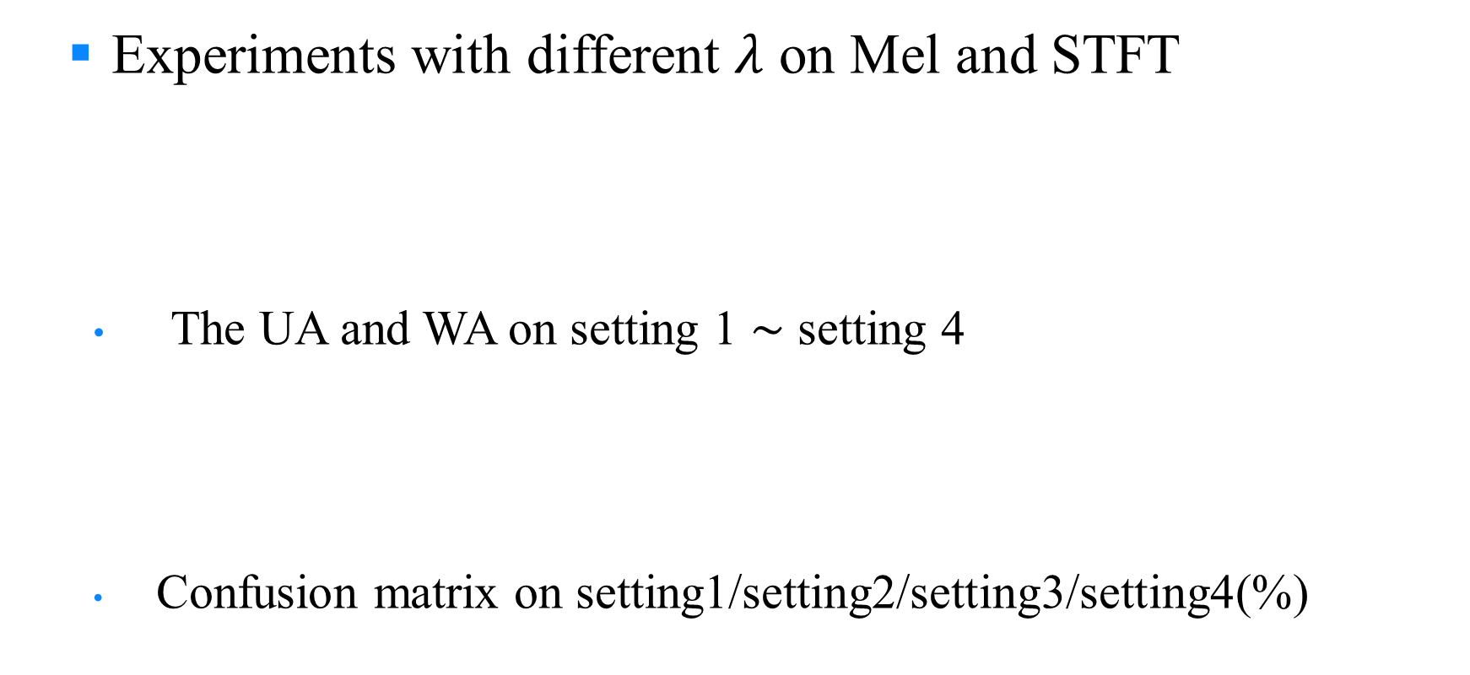
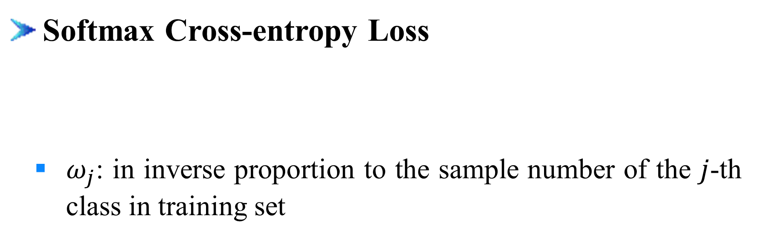
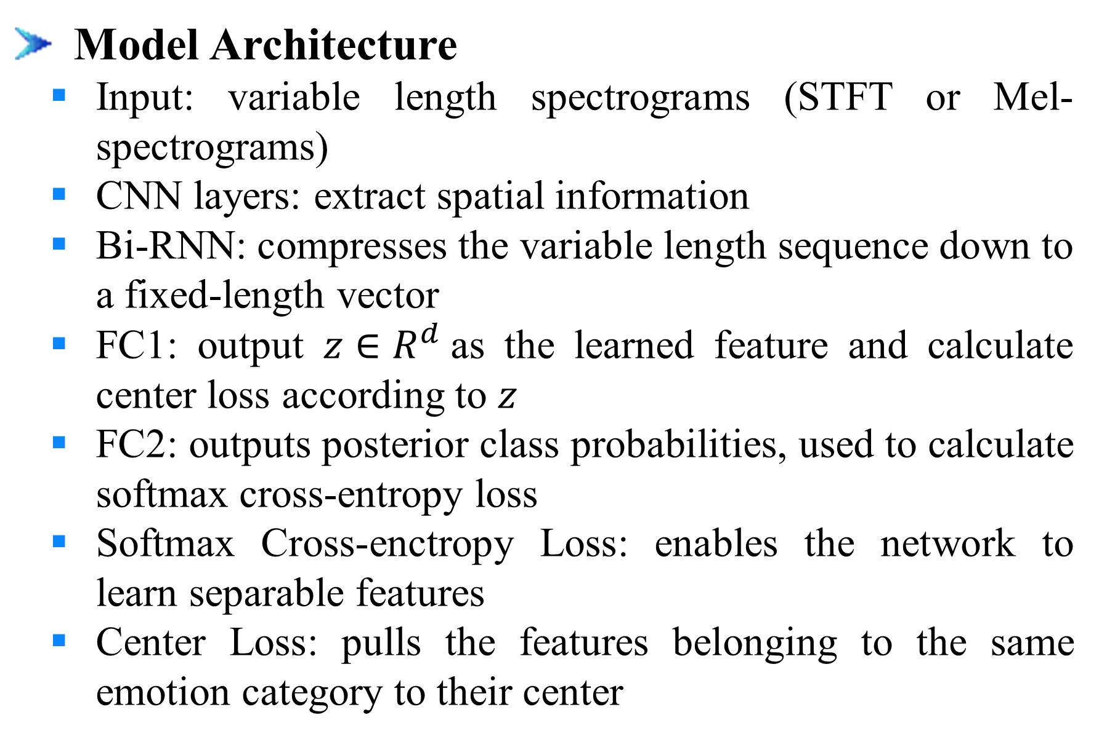
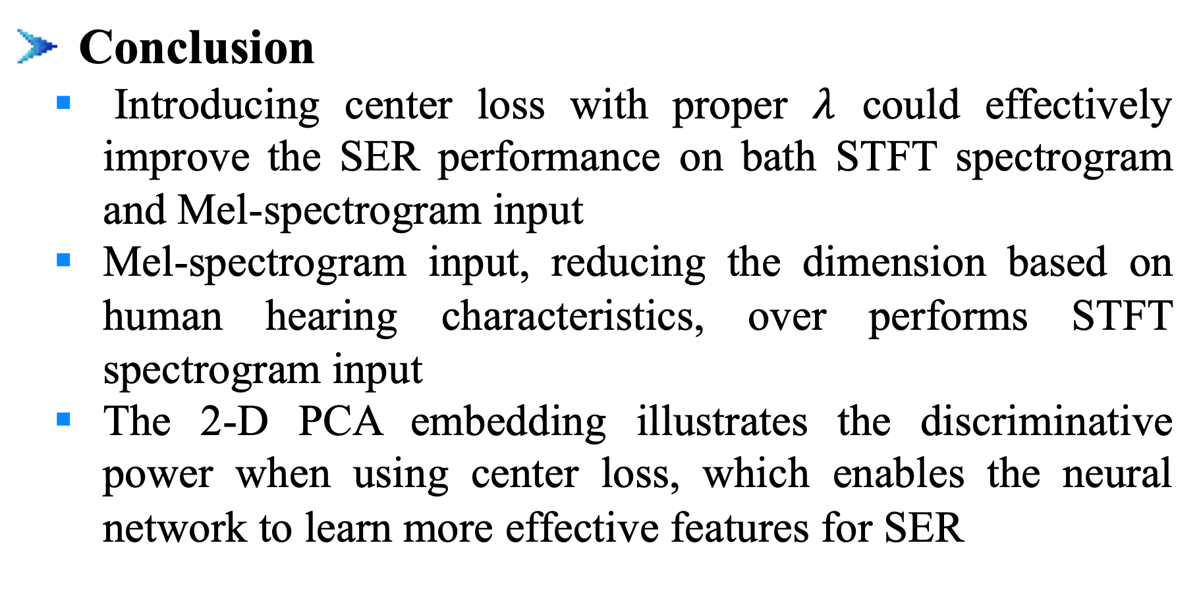

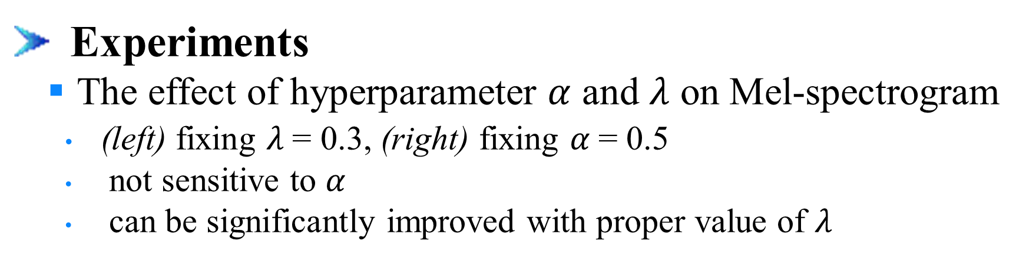
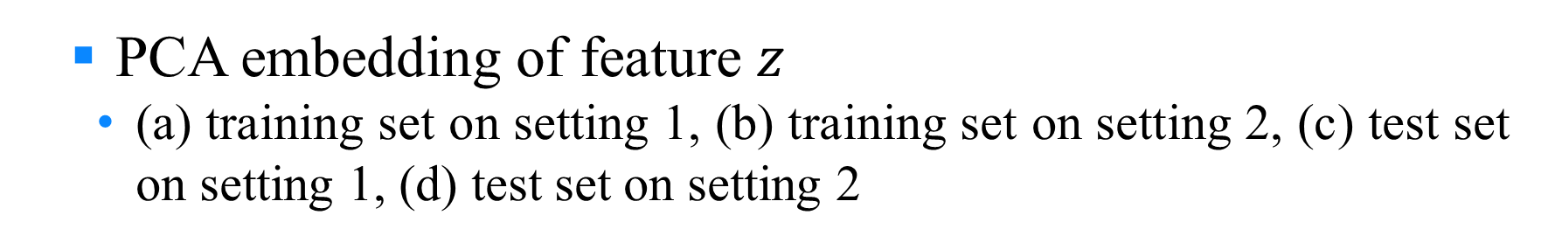
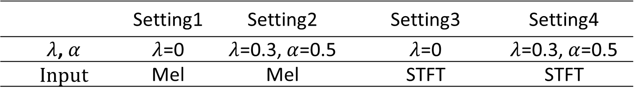
Learning Discriminative Features from Spectrograms using Center Loss for Speech Emotion Recognition
Dongyang Dai^{1,2}, Zhiyong Wu^{1,2,3}, Runnan Li^{1,2}, Xixin Wu³, Jia Jia^{1,2}, Helen Meng^{1,3}
¹Tsinghua-CUHK Joint Research Center for Media Sciences, Technologies and Systems, Graduate School at Shenzhen, Tsinghua University, Shenzhen, China ² Tsinghua National Laboratory for Information Science and Technology (TNList), Department of Computer Science and Technology, Tsinghua University, Beijing, China
³ Department of Systems Engineering and Engineering Management, The Chinese University of Hong Kong
1. Introduction
2. Proposed Method
Motivation
Extract valid features from raw data for emotion recognition
Center Loss
Reshape output: ${L′}_{T} ×d_{cnn} { (d_{cnn}=96⋅d′}_{T}$)
Center Loss
$L_{c}$: center loss
$c_{j}$: the global class center of features corresponding to the $j$-th emotion, ﻿updated per mini-batch iteration
${\dot{c}}_{j}$: ﻿the $j$-th class center of features from a mini-batch
$α$: controls the update rate of $c_{j}$
Joint Loss
$λ$: ﻿trades off center loss against softmax cross-entropy loss.
$$z$$
+
Reshape(Keep time axis)
Speech
Features
Emotion
Input
Softmax Cross-entropy Loss
2D convolutions output: ${L′}_{T} × L_{F}^{′}×$96
Concatenate
CNN-layers
Bi-RNN
FC1
Max-pooling: 2 $×$ 2, strides [2, 2]
FC2
Convolution: 96 filters of 3 $×$ 3, strides [1, 1]
Challenge
How to design a suitable model processing directly on raw data
Emotions are naturally ambiguous
Contribution
Extract features and identify emotions directly from spectrograms
Introduce center loss together with softmax corss-entropy loss in SER task to learn discriminative features
Separable inter-class features
More compact intra-class features
Model Architecture
Input: variable length spectrograms (STFT or Mel-spectrograms)
CNN layers: extract spatial information
Bi-RNN: compresses the variable length sequence down to a fixed-length vector
FC1: output $z∈R^{d}$as the learned feature and calculate center loss according to $z$
FC2: outputs posterior class probabilities, used to calculate softmax cross-entropy loss
Softmax Cross-enctropy Loss: enables the network to learn separable features
Center Loss: ﻿pulls the features belonging to the same emotion category to their center
Max-pooling: 2 $×$ 2, strides [2, 2]
Convolution: 80 filters of 3 $×$ 3, strides[1, 1]
Max-pooling: 2 $×$ 2, strides [2, 2]
Convolution: 64 filters of 3 $×$ 3, strides [1, 1]
Convolution: 48 filters of 7 $×$ 7, strides [2, 2]
Input: spectrogram L_{T} $× L_{F}$
Bi-RNN
CNN layers
Experimental Setup
Dataset: IEMOCAP
4 emotion categories: neutral, angry, happy and sad (happy and excited merged as happy)
﻿﻿﻿5 subsets
Randomly divided the total 5531 utterances, but keeping the distribution portion of emotion categories
4 subsets for training, half of the last subset as development set and half as test set
Settings of spectrograms
Model input: log scale STFT spectrogram or Mel-spectrogram
Hamming window: 40ms window length and 10ms shift
Sample rate: 16KHz
DTF length: 1024
The number of Mel bands: 128
Evaluation metrics
Unweighted Accuracy (UA): the mean value of the recall for each class
Weighed Accuracy (WA): the number of correctly classified samples divided by the total amount of samples
Softmax Cross-entropy Loss
$ω_{j}$: ﻿in inverse proportion to the sample number of the $j$-th class in training set
3. Experiments and Results
4. Conclusion
Experimental Setup
Data
Dataset: IEMOCAP
﻿Neutral, angry, happy, sad and excited (﻿merges happy and excited as happy, ﻿5531 utterances)
﻿﻿5 subsets (keep the emotion distribution), 4 subsets for training, half of the last subset as development set and half as test set
Settings of spectrograms
Model input: log scale STFT spectrogram or Mel-spectrogram
Hamming window
Window size: 40msec
Window Shift: 10msec
Sample rate： 16KHz
DTF length: 1024
The number of Mel bands: 128
Metrics
The unweighted accuracy: UA, the mean value of the recall for each class
The weighed accuracy: WA, the number of correctly classified samples divided by the total amount of samples
Experiments
The effect of hyperparameter $α$ and $λ$ on Mel-spectrogram
﻿(left) fixing $λ$= 0.3, (right) fixing $α$= 0.5
﻿not sensitive to $α$
﻿can be significantly improved with proper value of $λ$
﻿﻿ PCA embedding of feature $z$
﻿(a) training set on setting 1, (b) training set on setting 2, (c) test set on setting 1, (d) test set on setting 2
Conclusion
Introducing center loss with proper $λ$ could effectively improve the SER performance on bath STFT spectrogram and Mel-spectrogram input
Mel-spectrogram input, reducing the dimension based on human hearing characteristics, over performs STFT spectrogram input
﻿The 2-D PCA embedding illustrates the discriminative power when using center loss, ﻿which enables the neural network to learn more effective features for SER
﻿﻿ Experiments with different $λ$ on Mel and STFT
﻿The UA and WA on setting 1 $∼$ setting 4
Confusion matrix on setting1/setting2/setting3/setting4(%)
 | Setting1 | Setting2 | Setting3 | Setting4
﻿$λ$,$α$ | $λ$=0 | $λ$=0.3,$α$=0.5 | $λ$=0 | $λ$=0.3,$α$=0.5
﻿Input | Mel | Mel | STFT | STFT
5. Acknowledgment
This work is supported by National Natural Science Foundation of China (NSFC) (61433018, 61375027), joint research fund of NSFC-RGC (Research Grant Council of Hong Kong) (61531166002, N CUHK404/15) and National Social Science Foundation of China (13&ZD189)
 | Setting1 | Setting2 | Setting3 | Setting4
﻿UA(%) | 63.80 | 66.86 | 60.97 | 65.13
﻿WA(%) | 61.83 | 65.40 | 58.93 | 62.96
 | neutral | angry | happy | sad
neutral | 57.5/63.7/54.4/57.3 | 9.5/6.7/9.3/7.3 | 16.4/16.7/18.5/19.6 | 16.6/12.7/17.7/15.7
angry | 11.9/10.8/12.7/10.3 | 69.1/70.5/68.1/72.0 | 15.5/16.7/16.7/15.3 | 3.5/2.0/2.5/2.2
happy | 21.1/21.9/21.6/20.5 | 16.2/13.1/18.6/16.1 | 51.1/55.6/47.6/51.8 | 11.5/9.4/12.2/11.4
sad | 13.8/12.8/16.1/12.5 | 2.6/2.5/3.9/2.8 | 6.0/7.0/6.2/5.3 | 77.6/77.7/73.7/79.3

